Slide 1
Theorem 10.3.1 Heath-Jarrow-Morton no-arbitrage condition 10.3.4 HJM Under Risk-Neutral Measure
報告人: 汪文豪
報告日期: 2023.09.05

Slide 2
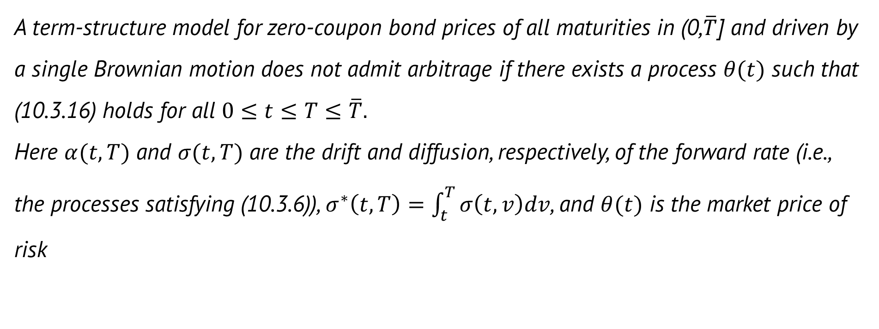
Theorem 10.3.1 (HJM no-arbitrage condition)
A term-structure model for zero-coupon bond prices of all maturities in (0,$\overline{T}$] and driven by a single Brownian motion does not admit arbitrage if there exists a process $θ(t)$ such that (10.3.16) holds for all $0≤t≤T≤\overline{T}.$ Here $α(t, T)$ and $σ(t, T)$ are the drift and diffusion, respectively, of the forward rate (i.e., the processes satisfying (10.3.6)), $σ^{∗}\left(t,T\right)=\int_{t}^{T}{σ\left(t,v\right)dv}$, and $θ(t)$ is the market price of risk
Notes:
若存在一個過程theta(t) 像是10.3.16， 則 (0, T bar] 中所有期限且由單個Brownian motion所驅動的零息債券期限結構模型是不會有套利產生的

Slide 3


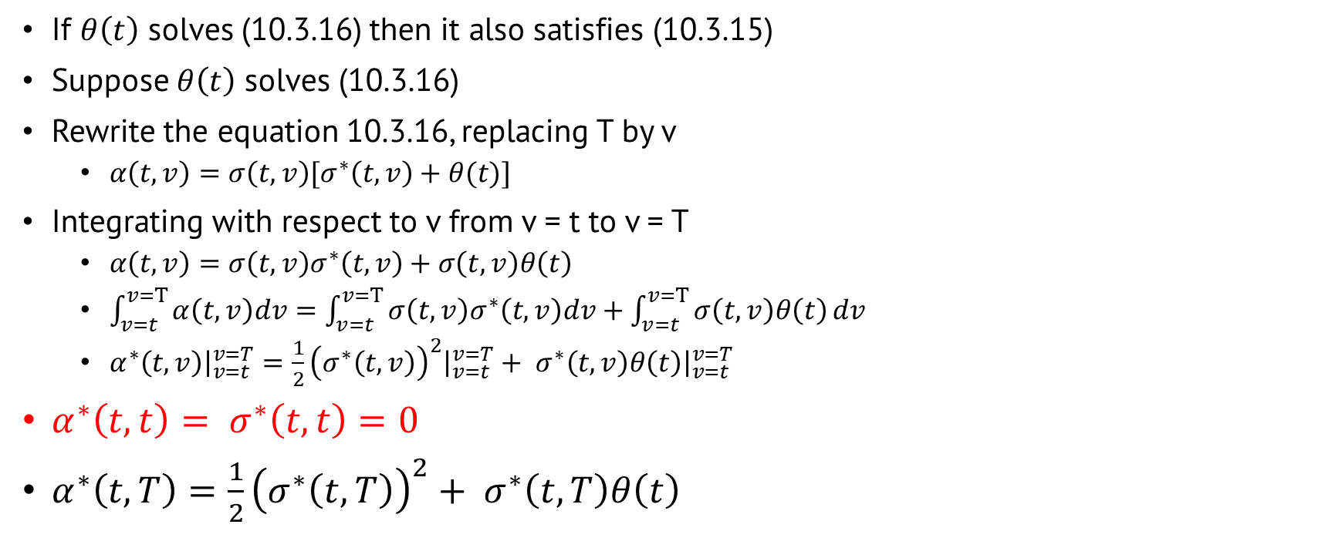
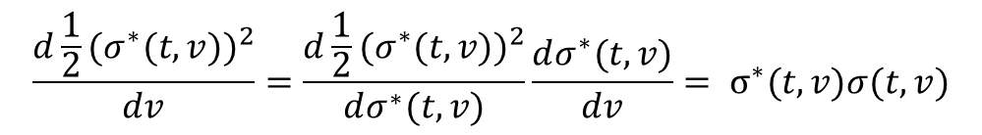
Proof
If $θ\left(t\right)$ solves (10.3.16) then it also satisfies (10.3.15)
Suppose $θ\left(t\right)$ solves (10.3.16)
Rewrite the equation 10.3.16, replacing T by v
$α\left(t, v\right)=σ\left(t, v\right)[σ^{∗}\left(t, v\right)+θ(t)]$
Integrating with respect to v from v = t to v = T
$α\left(t, v\right)=σ\left(t, v\right)σ^{∗}\left(t, v\right)+σ\left(t, v\right)θ\left(t\right)$
$\int_{v=t}^{v=T}{α\left(t, v\right)dv}=\int_{v=t}^{v=T}{σ\left(t, v\right)σ^{∗}\left(t, v\right)dv}+\int_{v=t}^{v=T}{σ\left(t, v\right)θ\left(t\right)}dv$
$α^{∗}\left(t, v\right){\left.​\right|}_{v=t}^{v=T}=\frac{1}{2}{\left(σ^{∗}\left(t, v\right)\right)}^{2}{\left.​\right|}_{v=t}^{v=T}+ σ^{∗}\left(t, v\right)θ\left(t\right){\left.​\right|}_{v=t}^{v=T}$
$α^{∗}\left(t, t\right)= σ^{∗}\left(t,t\right)=0$
$α^{∗}\left(t, T\right)=\frac{1}{2}{\left(σ^{∗}\left(t, T\right)\right)}^{2}+ σ^{∗}\left(t, T\right)θ\left(t\right)$
$$\frac{d\frac{1}{2}{{(σ}^{∗}(t,v))}^{2}}{dv}=\frac{d\frac{1}{2}{{(σ}^{∗}(t,v))}^{2}}{dσ^{∗}(t,v)}\frac{dσ^{∗}(t,v)}{dv}= σ^{∗}(t,v)σ(t,v)$$

Slide 4
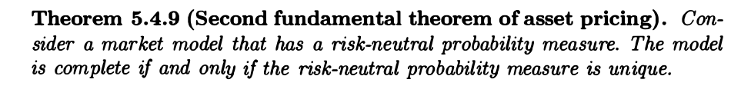
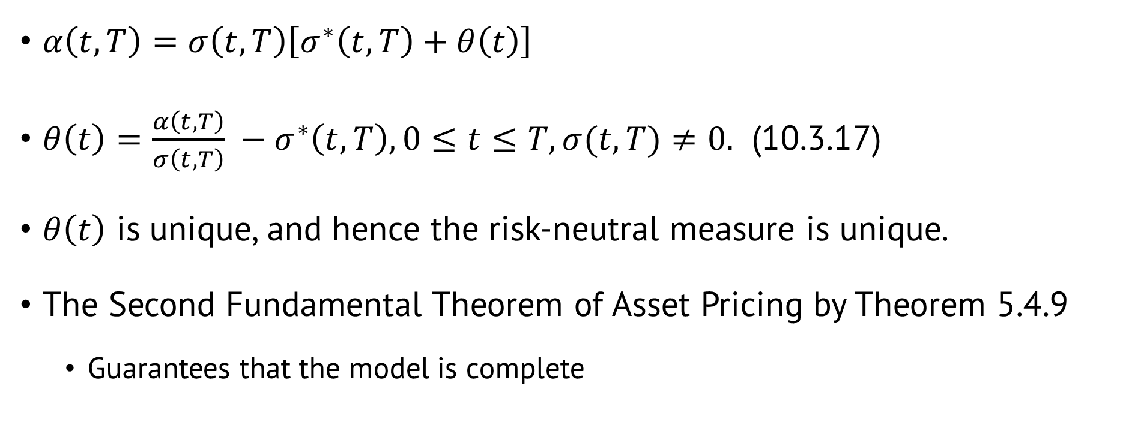
Proof (cont.)
$α\left(t, T\right)=σ\left(t, T\right)\left[σ^{∗}\left(t, T\right)+θ\left(t\right)\right]$
$θ\left(t\right)=\frac{α\left(t, T\right)}{σ\left(t, T\right)} −σ^{∗}\left(t, T\right), 0≤t≤T,σ(t, T)≠0.$ (10.3.17)
$θ\left(t\right)$ is unique, and hence the risk-neutral measure is unique.
The Second Fundamental Theorem of Asset Pricing by Theorem 5.4.9
Guarantees that the model is complete

Slide 5

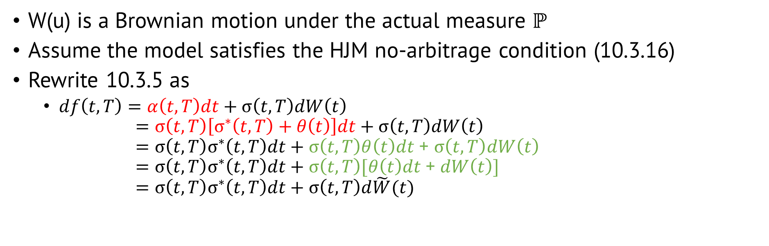
10.3.4 HJM Under Risk-Neutral Measure
W(u) is a Brownian motion under the actual measure $ℙ$
Assume the model satisfies the HJM no-arbitrage condition (10.3.16)
Rewrite 10.3.5 as
$df\left(t,T\right)=α\left(t, T\right)dt+σ\left(t,T\right)dW\left(t\right)$ $=σ\left(t,T\right)\left[σ^{∗}\left(t,T\right)+θ\left(t\right)\right]dt+σ\left(t,T\right)dW\left(t\right)$ $=σ\left(t,T\right)σ^{∗}\left(t,T\right)dt+σ\left(t,T\right)θ\left(t\right)dt$ + $σ\left(t,T\right)dW\left(t\right)$ $=σ\left(t,T\right)σ^{∗}\left(t,T\right)dt+σ\left(t,T\right)[θ\left(t\right)dt\text{ +} dW\left(t\right)]$ $=σ\left(t,T\right)σ^{∗}\left(t,T\right)dt+σ\left(t,T\right)d\tilde{W}(t)$

Slide 6
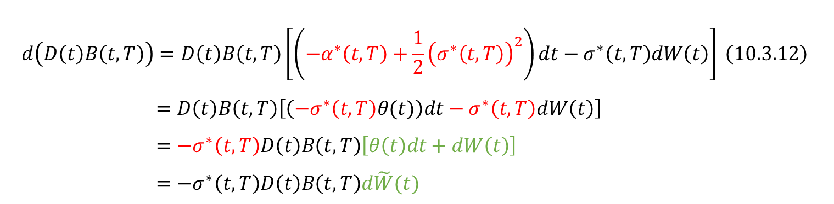
10.3.4 HJM Under Risk-Neutral Measure
Saw in the proof of Theorem 10.3.1
Rewrite the differential of the discounted bond price (10.3.12)
$$d\left(D\left(t\right)B\left(t,T\right)\right)=D\left(t\right)B\left(t,T\right)\left[\left(−α^{∗}\left(t,T\right)+\frac{1}{2}{\left(σ^{∗}\left(t,T\right)\right)}^{2}\right)dt−σ^{∗}\left(t,T\right)dW\left(t\right)\right] \left(10.3.12\right)$$
$=D\left(t\right)B\left(t,T\right)\left[\left(−σ^{∗}\left(t,T\right)θ(t)\right)dt−σ^{∗}\left(t,T\right)dW\left(t\right)\right]$ $=−σ^{∗}\left(t,T\right)D\left(t\right)B\left(t,T\right)\left[θ\left(t\right)dt+dW\left(t\right)\right]$ $=−σ^{∗}\left(t,T\right)D\left(t\right)B\left(t,T\right)d\tilde{W}(t)$

Slide 7
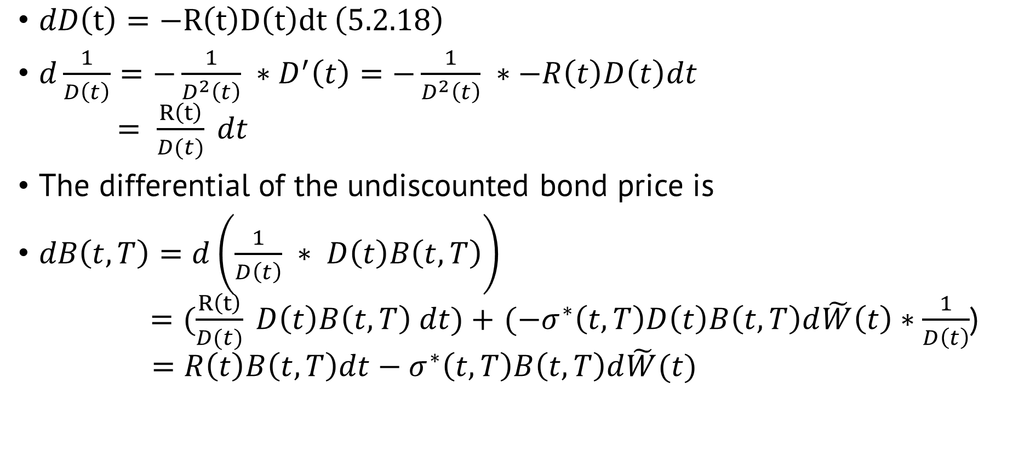
10.3.4 HJM Under Risk-Neutral Measure
$dD\left(t\right)=−R\left(t\right)D\left(t\right)dt \left(5.2.18\right)$
$d\frac{1}{D\left(t\right)}=−\frac{1}{D^{2}\left(t\right)} ∗D^{′}\left(t\right)=−\frac{1}{D^{2}\left(t\right)} ∗−R\left(t\right)D\left(t\right)dt$ $= \frac{R\left(t\right)}{D(t)} dt$
The differential of the undiscounted bond price is
$dB\left(t,T\right)=d\left(\frac{1}{D\left(t\right)} ∗ D\left(t\right)B\left(t,T\right)\right)$ $=(\frac{R\left(t\right)}{D(t)} D\left(t\right)B\left(t,T\right) dt)+$ $(−σ^{∗}\left(t,T\right)D\left(t\right)B\left(t,T\right)d\tilde{W}\left(t\right)∗\frac{1}{D\left(t\right)}$) $=R\left(t\right)B\left(t,T\right)dt−σ^{∗}\left(t,T\right)B\left(t,T\right)d\tilde{W}(t)$
$$d\left(D\left(t\right)B\left(t,T\right)\right)=−σ^{∗}\left(t,T\right)D\left(t\right)B\left(t,T\right)d\tilde{W}(t)$$

Slide 8
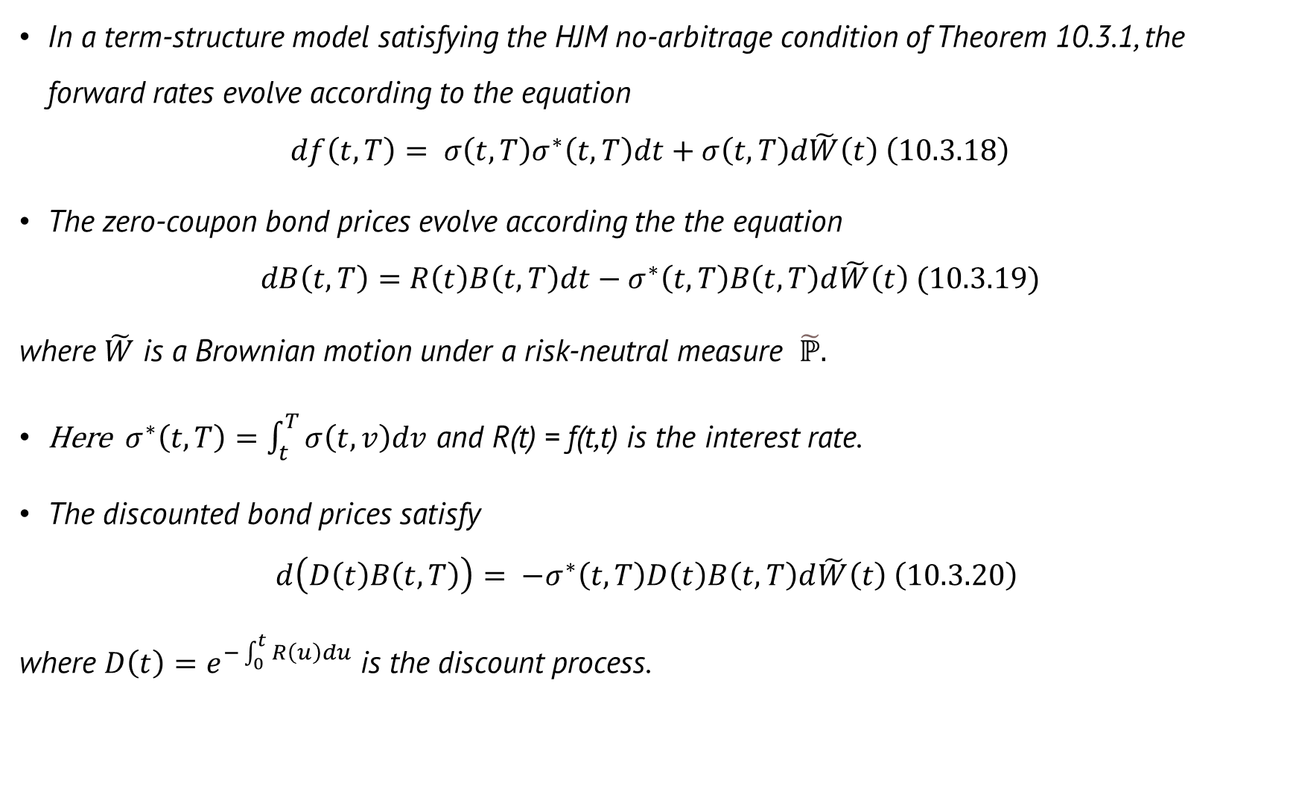
Theorem 10.3.2 (Term-structure evolution under risk-neutral measure)
In a term-structure model satisfying the HJM no-arbitrage condition of Theorem 10.3.1, the forward rates evolve according to the equation
$$df\left(t,T\right)= σ\left(t,T\right)σ^{∗}\left(t,T\right)dt+σ\left(t,T\right)d\tilde{W}\left(t\right) \left(10.3.18\right)$$
The zero-coupon bond prices evolve according the the equation $dB\left(t,T\right)=R\left(t\right)B\left(t,T\right)dt−σ^{∗}\left(t,T\right)B\left(t,T\right)d\tilde{W}\left(t\right) (10.3.19)$
where $\tilde{W}$ is a Brownian motion under a risk-neutral measure $\tilde{ℙ}.$
Here $σ^{∗}\left(t,T\right)=\int_{t}^{T}{σ\left(t,v\right)dv}$ and R(t) = f(t,t) is the interest rate.
The discounted bond prices satisfy
$$d\left(D\left(t\right)B\left(t,T\right)\right)= −σ^{∗}\left(t,T\right)D\left(t\right)B\left(t,T\right)d\tilde{W}\left(t\right) \left(10.3.20\right)$$
where $D\left(t\right)=e^{−\int_{0}^{t}{R\left(u\right)du}}$ is the discount process.

Slide 9
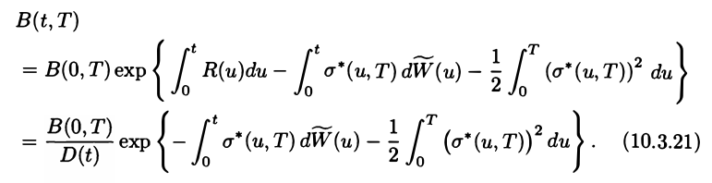
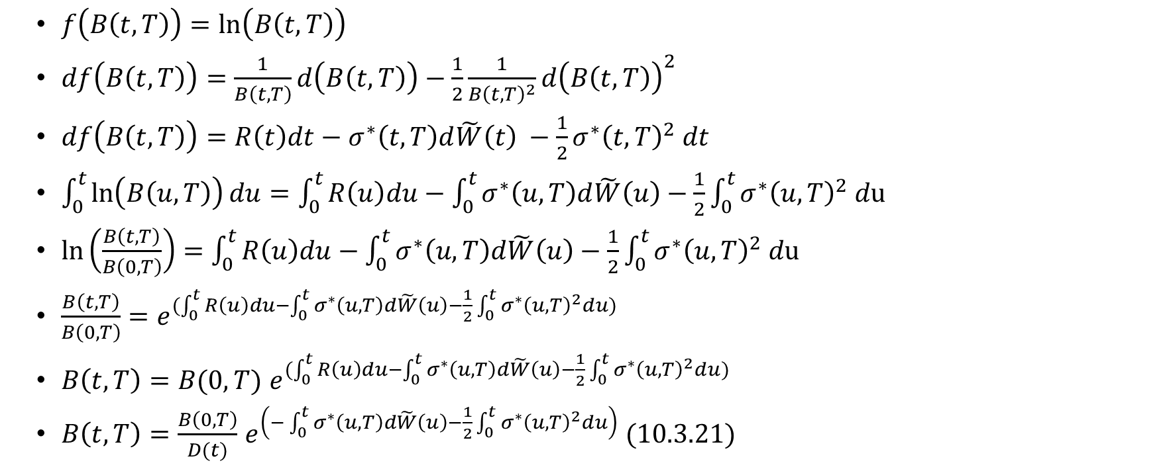
The solution to the stochastic differential equation (10.3.19) is
$$dB\left(t,T\right)=R\left(t\right)B\left(t,T\right)dt−σ^{∗}\left(t,T\right)B\left(t,T\right)d\tilde{W}\left(t\right) (10.3.19)$$
$f\left(B\left(t,T\right)\right)=\ln\left(B\left(t,T\right)\right)$
$df\left(B\left(t,T\right)\right)=\frac{1}{B\left(t,T\right)}d\left(B\left(t,T\right)\right)−\frac{1}{2}\frac{1}{B{\left(t,T\right)}^{2}}d{\left(B\left(t,T\right)\right)}^{2}$
$df\left(B\left(t,T\right)\right)=R\left(t\right)dt−σ^{∗}\left(t,T\right)d\tilde{W}\left(t\right) −\frac{1}{2}σ^{∗}{\left(t,T\right)}^{2} dt$
$\int_{0}^{t}{\ln\left(B\left(u,T\right)\right)du}=\int_{0}^{t}{R\left(u\right)du}−\int_{0}^{t}{σ^{∗}\left(u,T\right)d\tilde{W}\left(u\right)−\frac{1}{2}}\int_{0}^{t}{σ^{∗}{\left(u,T\right)}^{2} d\text{u} }$
$\ln\left(\frac{B\left(t,T\right)}{B\left(0,T\right)}\right)=\int_{0}^{t}{R\left(u\right)du}−\int_{0}^{t}{σ^{∗}\left(u,T\right)d\tilde{W}\left(u\right)}−\frac{1}{2}\int_{0}^{t}{σ^{∗}{\left(u,T\right)}^{2} d\text{u} }$
$\frac{B\left(t,T\right)}{B\left(0,T\right)}=e^{(\int_{0}^{t}{R\left(u\right)du}−\int_{0}^{t}{σ^{∗}\left(u,T\right)d\tilde{W}\left(u\right)}−\frac{1}{2}\int_{0}^{t}{σ^{∗}{\left(u,T\right)}^{2}du})}$
$B\left(t,T\right)=B(0,T)$ $e^{(\int_{0}^{t}{R\left(u\right)du}−\int_{0}^{t}{σ^{∗}\left(u,T\right)d\tilde{W}\left(u\right)}−\frac{1}{2}\int_{0}^{t}{σ^{∗}{\left(u,T\right)}^{2}du})}$
$B\left(t,T\right)=\frac{B\left(0,T\right)}{D(t)}$ $e^{\left(−\int_{0}^{t}{σ^{∗}\left(u,T\right)d\tilde{W}\left(u\right)}−\frac{1}{2}\int_{0}^{t}{σ^{∗}{\left(u,T\right)}^{2}du}\right)} (10.3.21)$
$$dB{\left(t,T\right)}^{2}=σ^{∗}{\left(t,T\right)}^{2}B{\left(t,T\right)}^{2}dt$$
$$D\left(t\right)=e^{−\int_{0}^{t}{R\left(u\right)du}}$$

Slide 10
Thanks for listening

